Slide 1

Smallholder Crop Production and Marketing Project (SCPMP)
Report from July 2010-March 2011.
Nkhata-bay District Office.

Slide 2
Executive Summary
The Government of Malawi with the support from The African Development Bank Group is implementing the Smallholder Crop Production and Marketing Project (SCPMP) through the Ministry of Irrigation and Water Development(MoIWD).SCPMP aims at contributing to poverty reduction and food security in rural Malawi.

Slide 3
Executive Summary cont’n
The specific objective of the project is to increase productivity and income of rural households in the project area.
The project is being implemented in the following District Assemblies:Chitipa,Karonga,Rumphi,Nkhat-bay,Mzimba,Dowa,Ntchisi,Nkhotakota,Lilongwe,Mchinji,Dedza,Ntcheu,Balaka,Machinga,Mangochi,Zomba,Chikhwawa and Nsanje.

Slide 4
Executive Summary cont’n
In Nkhata-bay the project is operating Chombe section, Lilezi Scheme, which is in Limphasa EPA. The targeted number of farmers is 174.

Slide 5
Activities, targets and achievements
Activity | Target | Achieved | Female farmers | Male farmers | Remarks
Train farmers in agribusiness development | 60 | 30 | 22 | 8
Train farmers in market information systems and development of contract farming | 60 | 28 | 16 | 12
Train farmers in crop production and post harvest handling | 60 | 74 | 54 | 20
Train VHCs members on mitigation of health aspects (water borne infections)related to irrigation | 60 | 27 | 15 | 12

Slide 6
Activities, targets and achievements
Activity | Target | Achieved | Remarks
Construct communal storage facility | 1 facility | 0 | Contractor abandoned the project
Facilitate construction of market centre | 1 centre | 1 | In progress
Train village health committees | 2 committee | 2 | 100% done, 1 health & 1 main
Conduct monthly site meeting | 12meetings | 9 m’tings
Train ToT (Trainer of trainers) in cooperative development and community sensitisation | 1 session | 1 | 100% done
Conduct joint supervision | 4 visits | 3 visits
Conduct food and nutrition security survey | 1 survey | 1

Slide 7
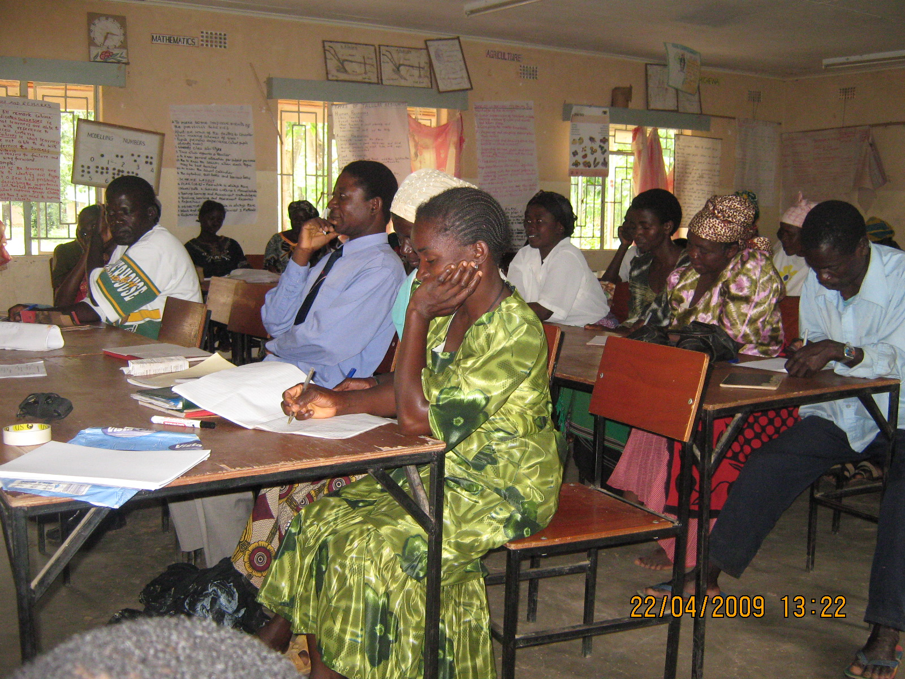
Activities, targets and achievements
Activity | Target | Achieved | Remarks
Train farmers in market competitiveness study | 174 farmers | 30males,74 females | More women because men are working with Vizala rubbber factory

Slide 8
CHALLENGES
Abandoning of some construction projects by contractors i.e storage facility
Delay in completion of projects by contractors i.e. market centre

